Slide 1
CM and DM EMI Analysis
30 September, 2014
Manoj Gulati

Slide 2
Why phase information is lost?
Phase information is lost in spectrum analyzers as they don’t preserve phase information while going through heterodyning process. [Agilent Report on Spectrum Analyzers]. They are meant to measure the power of the spectrum and shows only magnitude vs. frequency with in full range of instrument.
Vector Signal Analyzer measure the magnitude and phase of an input signal at a single frequency with in the IF bandwidth. Primary use is to make in channel measurements like error vector magnitude, spectral flatness on known signals.
Latest signal Analyzers provides the function of both of them. (Depends on model).
NB: Need to check this with Agilent if our N9000CXA support this.

Slide 3
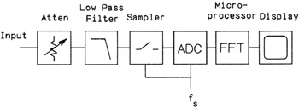
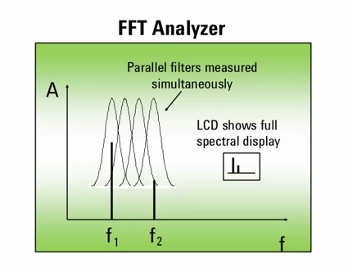
Types of Spectrum Analyzers
FFT Analyzer

Slide 4
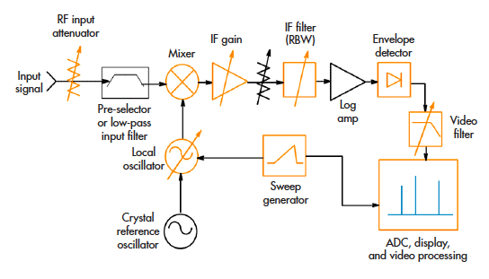
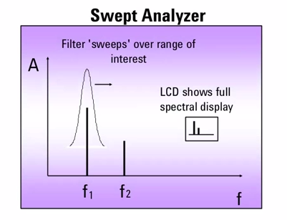
To select resolution of spectrum you want to visualize. This decides the actual resolution but inversely prop. With Sweep time.
Restrict the BW of signal fed to Mixer
Swept Analyzer
Heterodyning
IF Stage
Capture the envelope of signal like CRT Y-plates. (Video Signal)
Working principal of majority of spectrum analyzers.
ADCs to control Y and X axis of display very similar to CRO/CRTs
Take the average of output signal. Similar to LPF action

Slide 5
Idea: USRP as a Data Acquisition System to Capture CM and DM mode Conducted EMI
Currently we are capturing time domain data using USRP and doing FFT offline on MATLAB. So we have phase information in that data.
But we were capturing differential mode EMI only. We can modify HPF to work in split phase and than it can be used to capture Vphase and Vneutral.
Numerical algorithm in MATLAB can separate CM and DM components.

Slide 6
References
Agilent Guide : Fundamentals of Spectrum Analysers
Agilent Video Tutorials : Fundamentals of Spectrum Analyzers

